Slide 1

Introduction
ENGLISH SOUND SYSTEM

Slide 2
How many alphabets are there in English?

Slide 3
1

Slide 4
ENGLISH SOUND SYSYEM
Integration of vowel and consonant sounds
Relates to sound classifications within the English language
Study of the sound system is called Phonology
There are 44 sounds (Phonemes)
A phoneme is a speech sound
It’s the smallest unit of sound

Slide 5
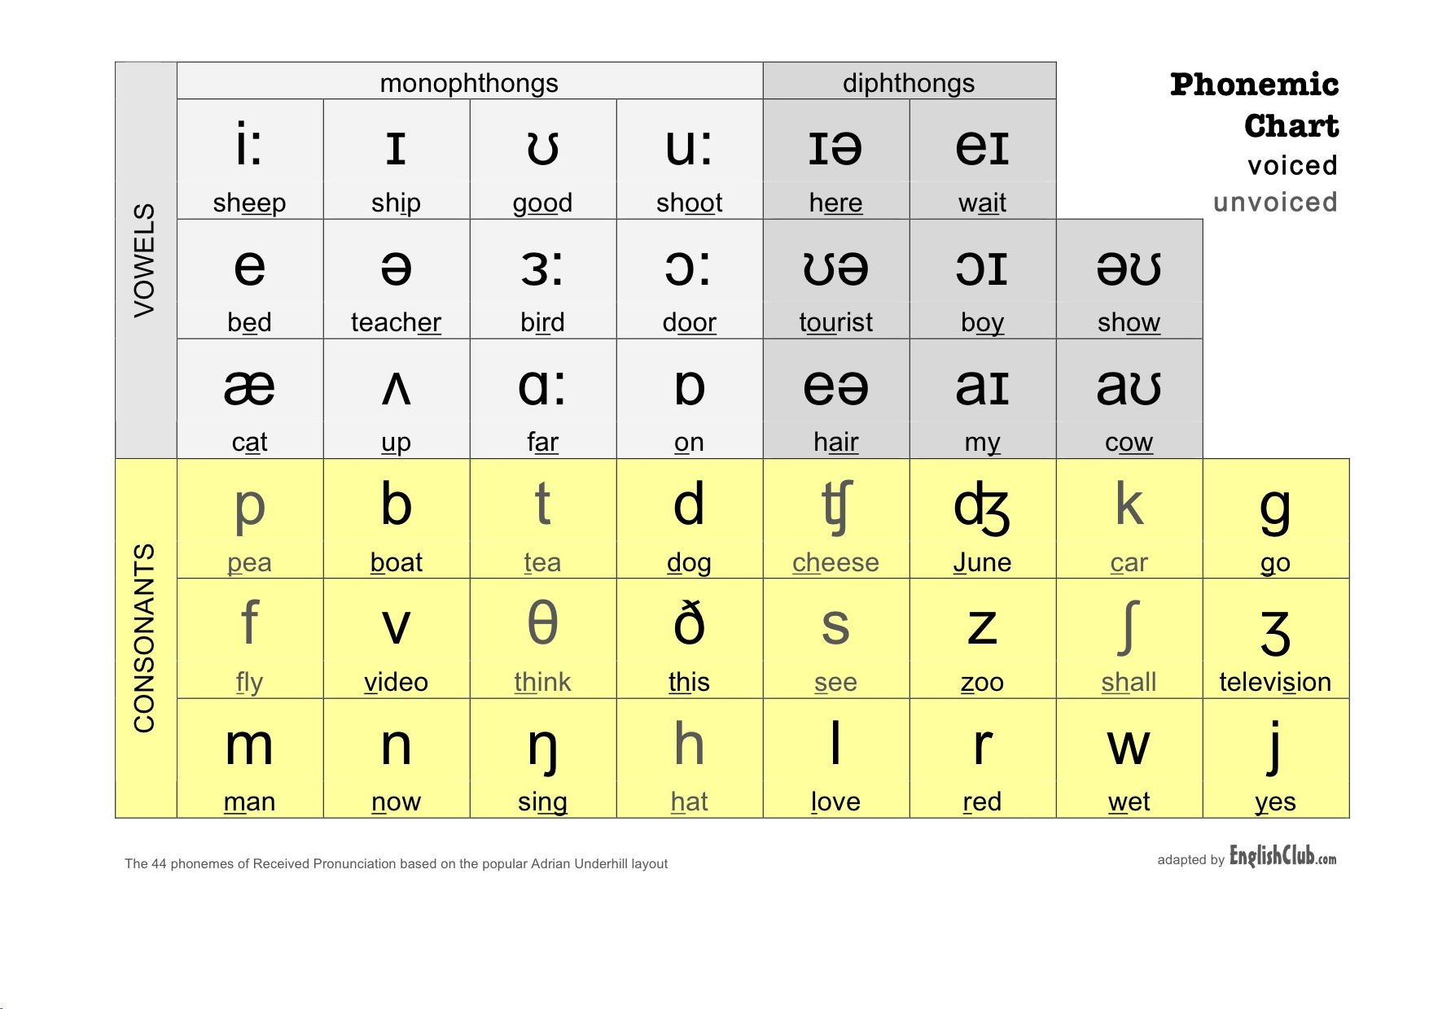
ENGLISH SOUND SYSYEM

Slide 6
CONSONANT
Refer to the letters of the English alphabet other than the five vowels (a, e, i, o, u).
They include letters that are pronounced by obstructing the flow of air in the vocal tract.
Among 44 speech sounds, 24 are consonant sounds

Slide 7
CONSONANT SOUNDS (PAIRED)
/p/ pet, top
/b/ bat, tub
/t/ trunk, what
/d/ dose, ward
/k/ keep, poke
/g/ game, bag
/f/ front, leaf
/v/ vase, advice

Slide 8
CONSONANT SOUNDS (PAIRED)
/s/ save, bus
/z/ zest, doze
/θ/ think, teeth
/ð/ there, leather
/ʃ/ shoes, cushion
/ʒ/ beige, measure
/tʃ/ catch, patch
/dʒ/ badge, judge

Slide 9




SINGLE CONSONANTS
Single consonants because each one is produced in a unique way
Make
Man
Money
Month
Now
Need
Number
Run
Bring
Young
Long
Morning
How
Home
Health
Hold

Slide 10




SINGLE CONSONANTS
Look
Real
Life
Old
Right
Run
Already
Reach
Why
Weather
One
Win
You
Year
Million
Continue

